Slide 1
MYSTIC.IO
PRESENTATION

Slide 2
WELCOME
HackTech
2020
The world's best interdisciplinary hackathon, held at Caltech in Pasadena, CA! Meet hackers from all over the world and create projects to solve problems at the intersections of fields ranging from education to games/entertainment using anything from hardware to machine learning, all while having a sensational time!!

Slide 3
MYSTIC.IO
Behold
Only For Procrastinators !!

Slide 4
Need Espresso every night ?
Well, not
Anymore !!

Slide 5
Mystic is an open-source project designed to help developers instantly get the most optimized code for their respective intended input and output with additionally providing them with 4 different coding language export namely C,C++,Python and Java
Mystic is an open-source project designed to help developers instantly get the most optimized code for their respective intended input and output with additionally providing them with 4 different coding language export namely C,C++,Python and Java.
M
Mystic is an open-source project designed to help developers instantly get the most optimized code for their respective intended input and output with additionally providing them with 4 different coding language export namely `C`,`C++`,`Python` and `Java`.

Slide 6
873
563
669
CHOOSE YOUR INPUT
CHOOSE YOUR
OUTPUT
CHOOSE YOUR
LANGUAGE OF CODE
THIS IS ABOUT PROGRAMMING
THE PROGRAM
06 March 2020

Slide 7
MAIN FEATURE
Code in any,
Get in any
Instantly code to what you need
Help programmers globally to pace up

Slide 8
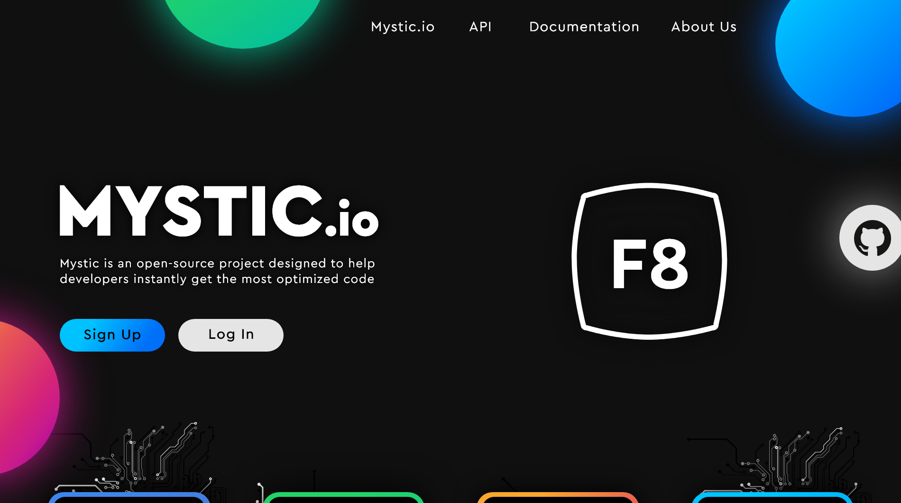
Frontend
Wireframes
A wonderful serenity has taken possession of my entire soul, like these sweet mornings of spring which I enjoy with my whole heart. I am alone

Slide 9
Deep Learning into AI
2020
10GB
2021
100GB
2023
500GB
2025
1TB
By the end of this year,
We will be having 10GB worth of datasheet consisting of applied cases by programmers around the world
Enough to inference and train our Deep Learning model for recognizing over vast variety of functions
DAMN !! It’s finally time to deploy our Model publicly and FROM NOW ON users just to speak what do they want and ‘dish will be served’
Behold our first AI that can generate functions based on problem
on it’s own……!

Slide 10
WHAT HAVE WE DONE
Currently, we are approaching towards integration of PyTorch in our project to generate variety of inferences from a given data set
After a nerve breaking session, we have successfully integrated eBay’s Analytics API as well as Google Cloud’s BigQuery API
Programmed an entire Python Backend System to generate Function as per user need
Created wireframes of our final ready-to-deploy website

Slide 11
What’s next //
INNOVATION
REVENUE
As of now, programming of multi-language conversion is under development which when deployed will be able to convert a program from one programming language to another programming language among C, C++, Python, Java. This will be handy for most of the programming project and user will be provided with instant language transfer as per his/her designed system compatibility.
Login/ Sign Up
After acquiring a considerable amount
Of traffic on site, we will be restricting access to limited amount of functionalities
Each User has to create an account on our database in order to access our platform

Slide 12
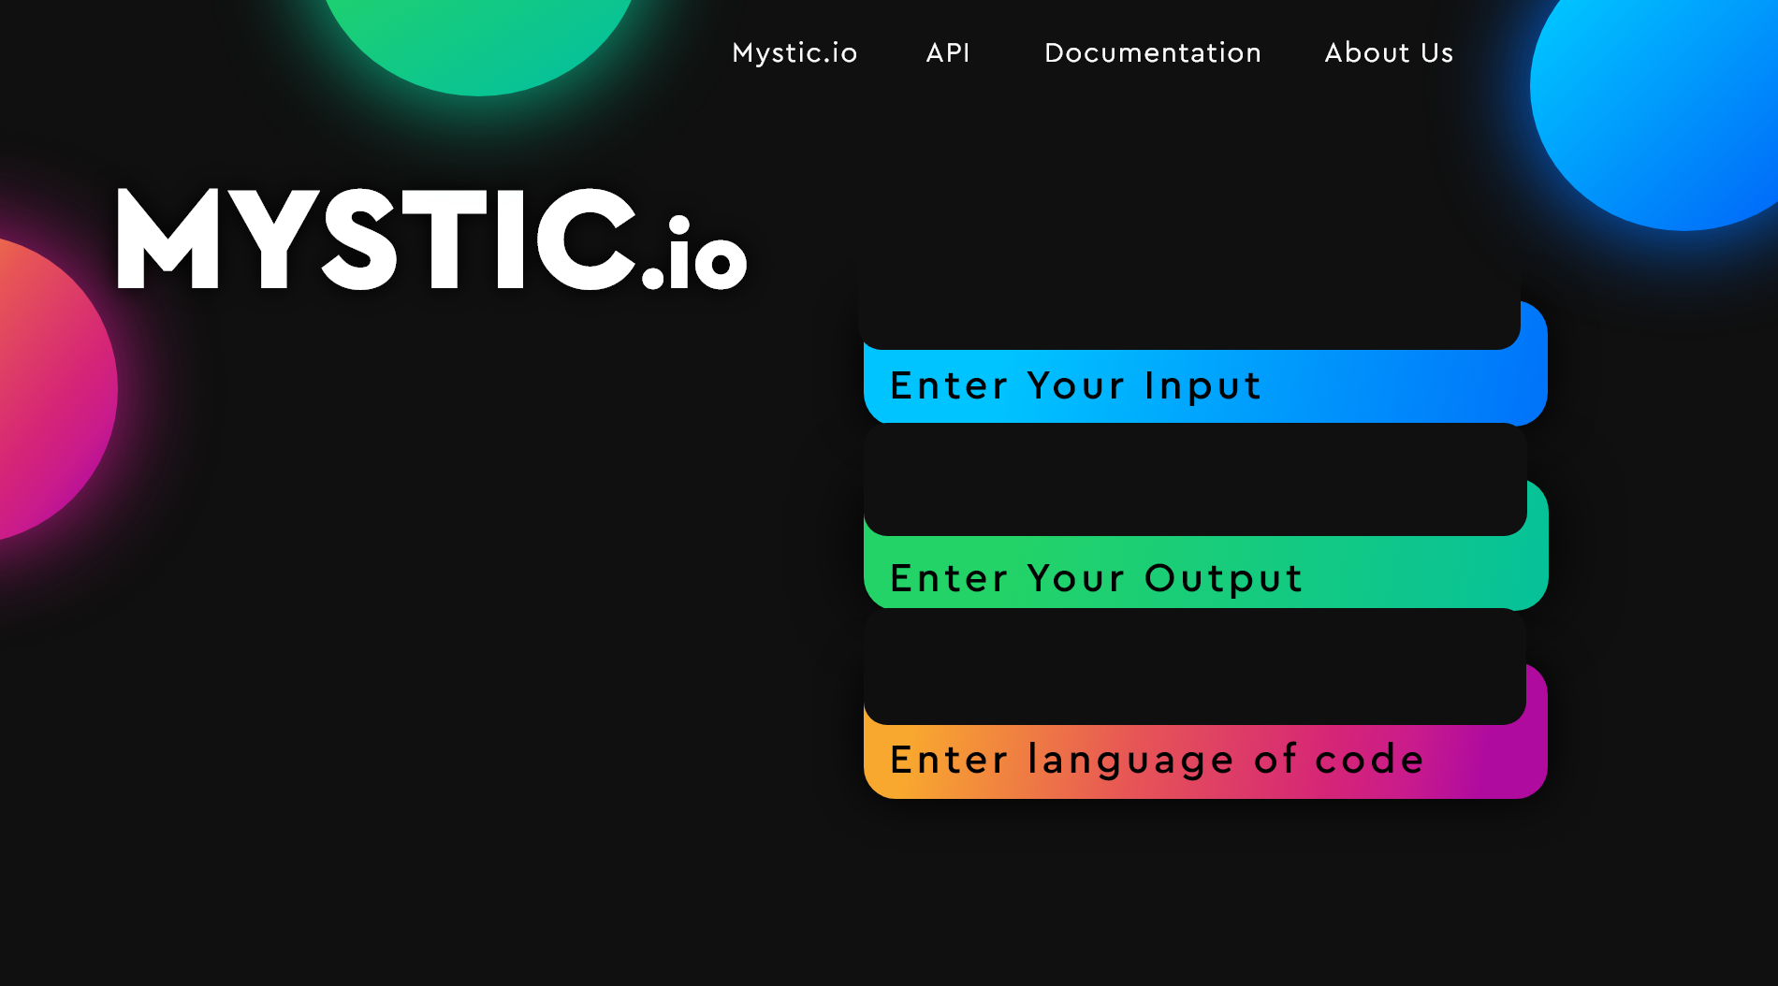
Login/ Sign Up
01

Slide 13
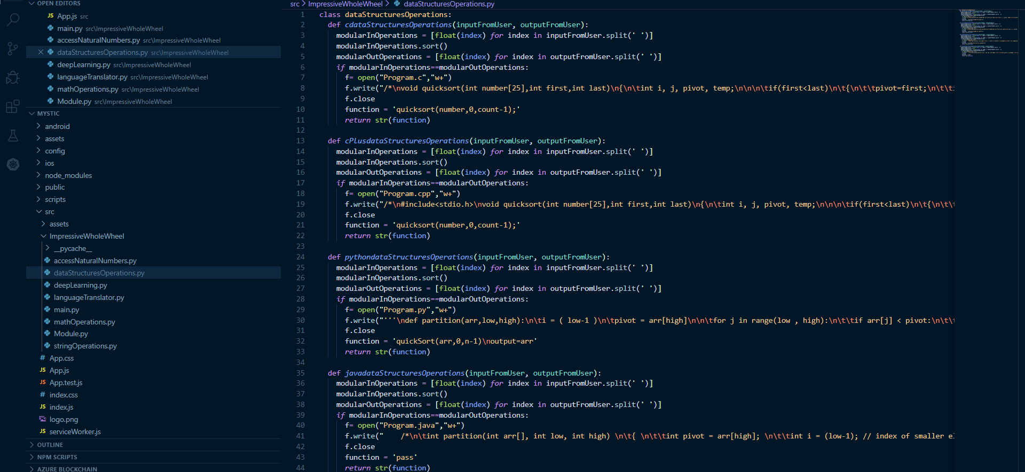
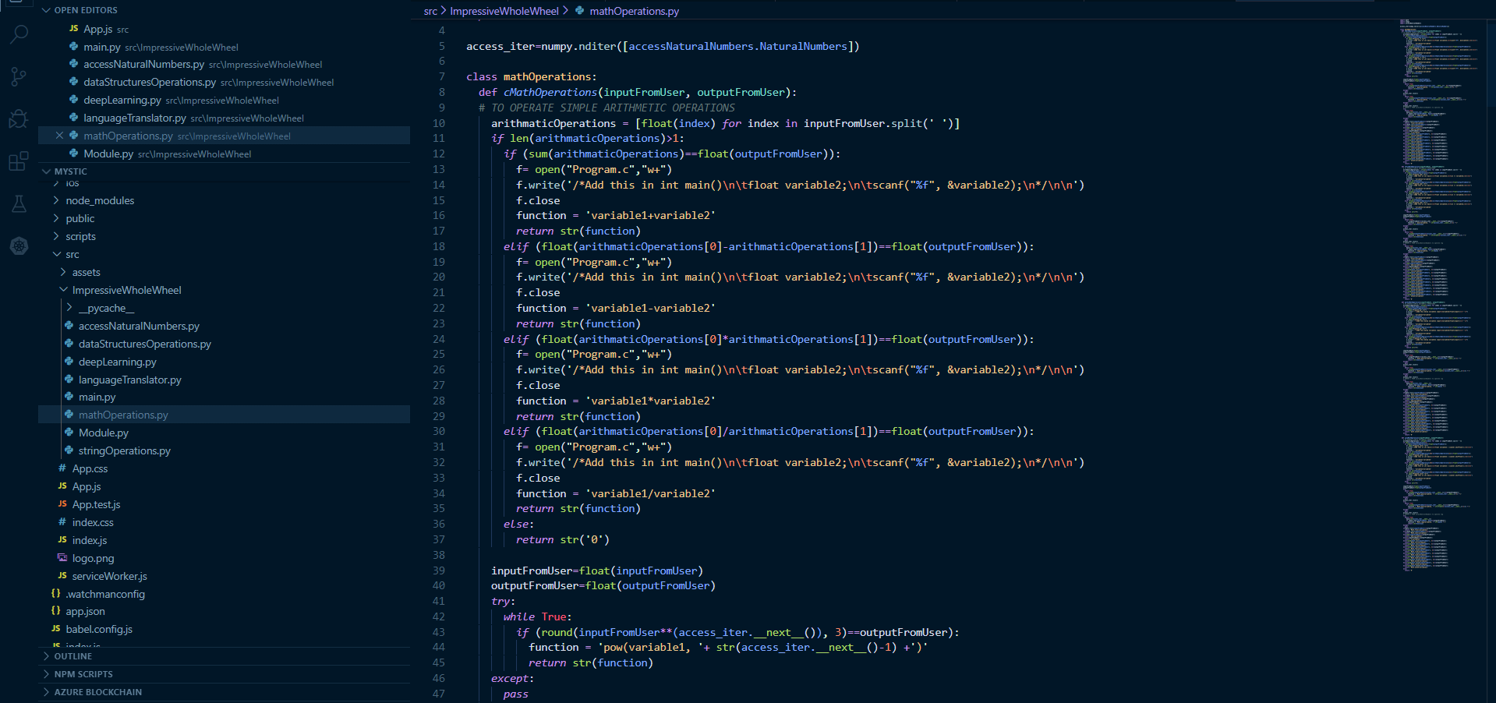
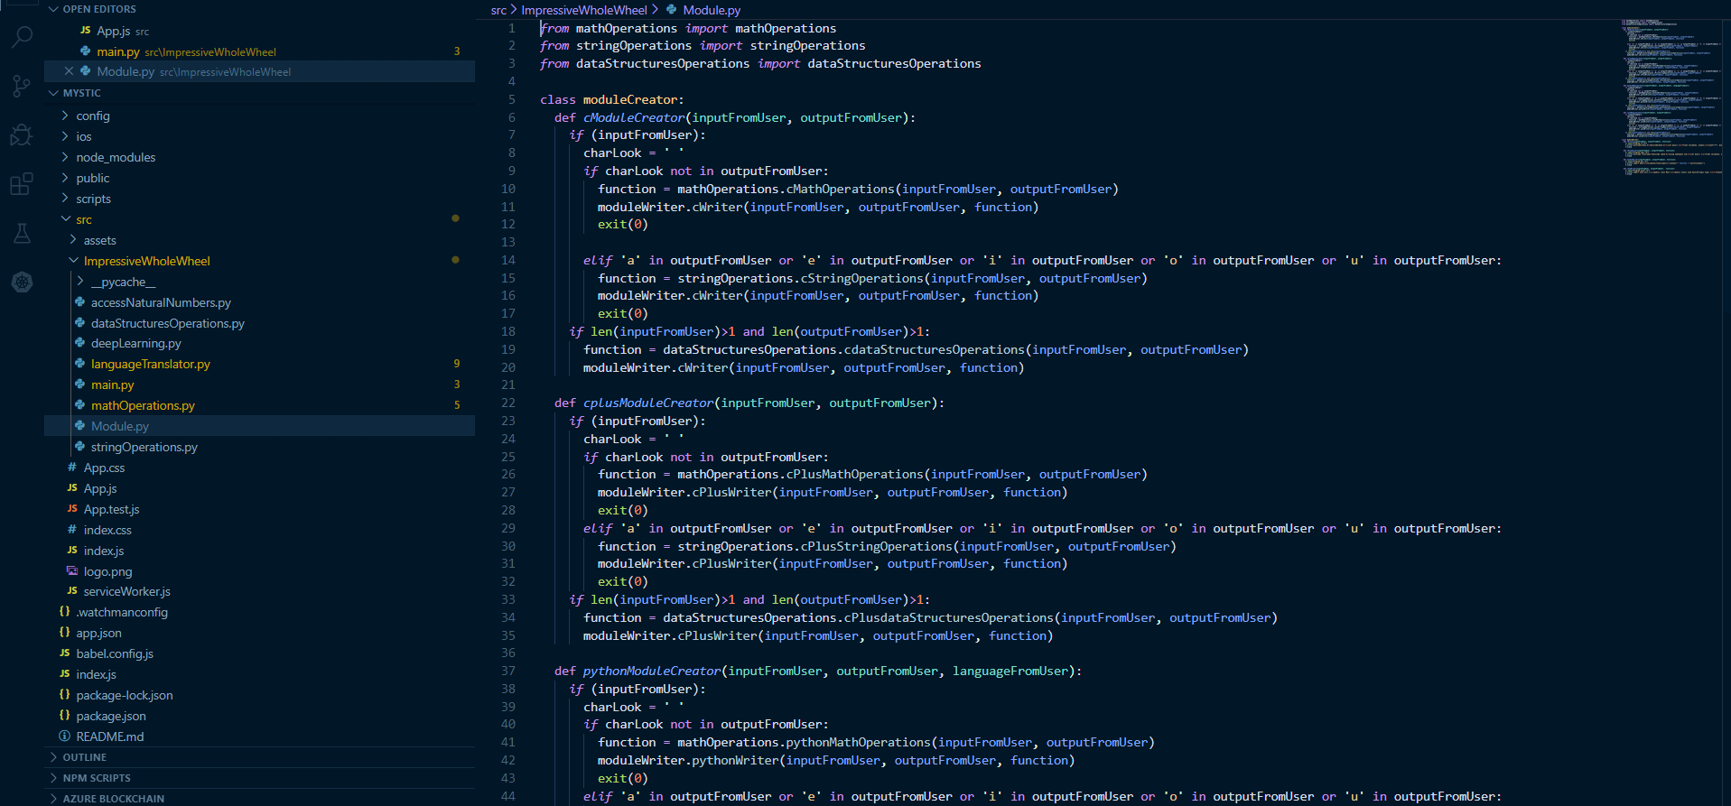
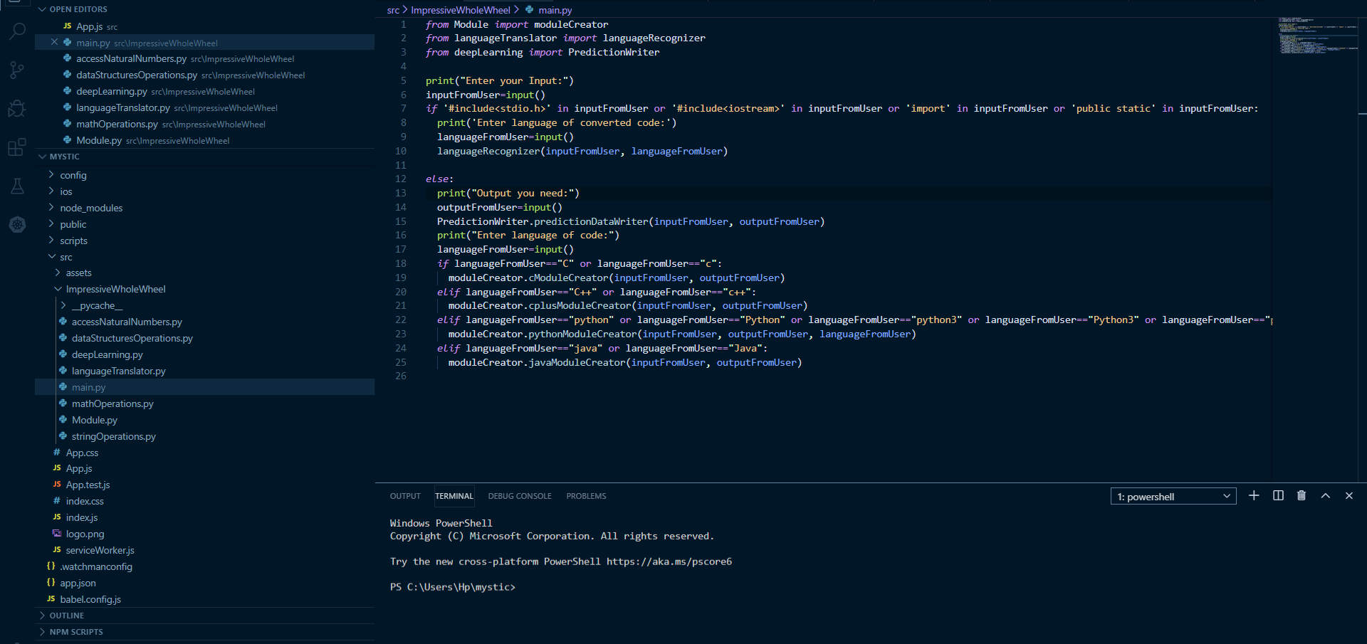
13
BUSINESS
Backend
Component Module

Slide 14
01
MATHEMATICAL OPERATIONS
02
STRING-RELATED OPERATIONS
Functionalities
AVAILABLE
AS OF NOW //
03
LANGUAGE TRANSLATOR
04
DATA STRUCTURES OPERATIONS
05
OPTION FIVE
A wonderful serenity has taken possession of my entire soul, like these sweet mornings

